Slide 1


Chiller and dry products Factory:
Sales And Profit Report
Comprehensive Report of Chiller and dry Products Shop :
Sales And Profit Performance
by Ahmed Said

Slide 2

Agenda
Data Set Overview
Data Manipulation With
Python
3
Power BI Report
Conclusion
1
2
4

Slide 3
1- Data Set Overview
This dataset consists of six related excel and csv’s workbooks ( one fact table with five dimension tables
1-Sales is a (Fact table) with 21 columns and 26397 rows :
Columns ( sale key, city key , customer key , bill to customer key , stock item key , invoice data key , delivery date key ,
salesperson key , WWI invoice ID , description , package , quantity , unit price , tax rate , total excluding tax , tax amount , profit ,
Total including tax , total dry items , total chiller items , linage key , cost )
2-City is a (dimension table) with 7 columns and 13028 rows:
Columns ( city key , city , state province , country , sales territory , location , latest recorded population )
3-customer is a (dimension table) with 12 columns and 403 rows:
Columns ( customer key , WWI customer ID , customer , bill to customer , category , buying group , primary contact ,postal code ,
Credit limit , lineage key )
4-date is a (dimension table) with 14 columns and 1460 rows:
Columns ( date , day number , day , month , short month , calendar month number , calendar month label , calendar year ,
Calendar year label , fiscal moth number , fiscal month label , fiscal year , fiscal year label ISO week number )

Slide 4
Count..
5-Stock Item is a (dimension table) with 21 columns and 673 rows:
Columns ( stock item key , WWI stock item ID , stock item , color , selling package , buying package , brand , size , local time days ,
Quantity per outer , is chiller stock , barcode , tax rate , unit price , recommended retail price , typical weight per unit , valid from ,
Valid to , lineage key )
6-Employee is a (dimension table) with 9 columns and 212 rows:
Columns ( employee key , WWI employee ID , employee , preferred name , is salesperson , photo , valid from , valid to , lineage key )

Slide 5
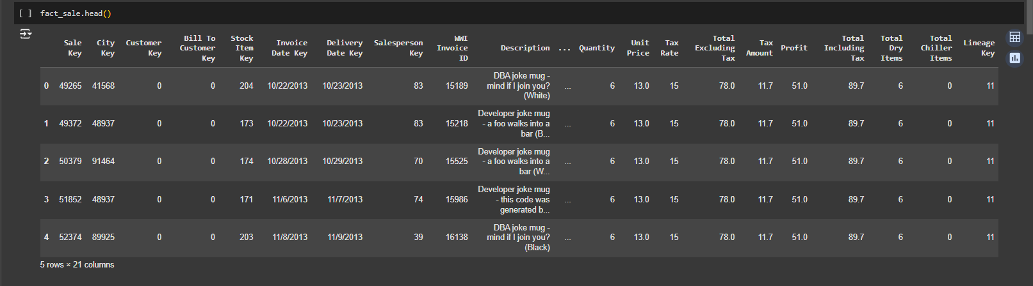
Count..
Fact Sale Table

Slide 6
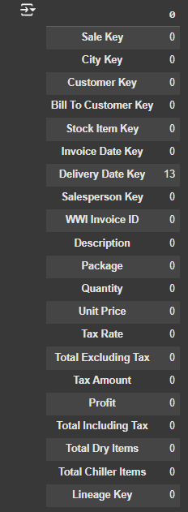
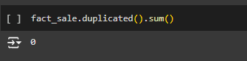
2- Data Set Manipulation With Python
In this stage we ensure that there is no null or duplicated data :

Slide 7
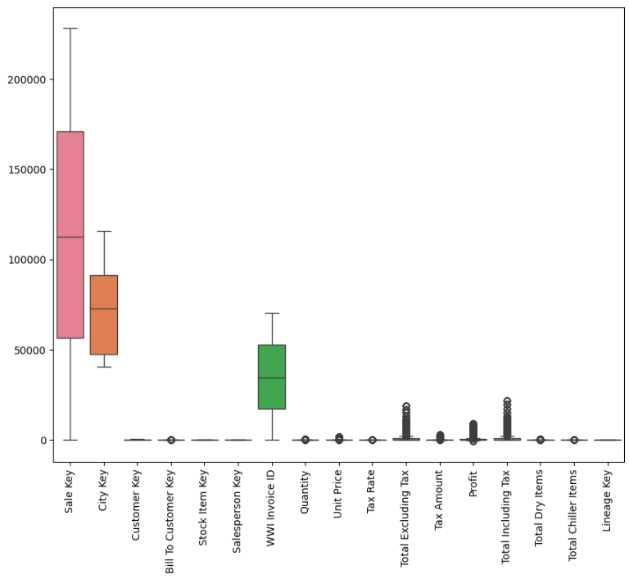
2- Data Set Manipulation With Python
In this stage we will check for the outliers :
We decided not to remove outliers because
they are real and expressive

Slide 8
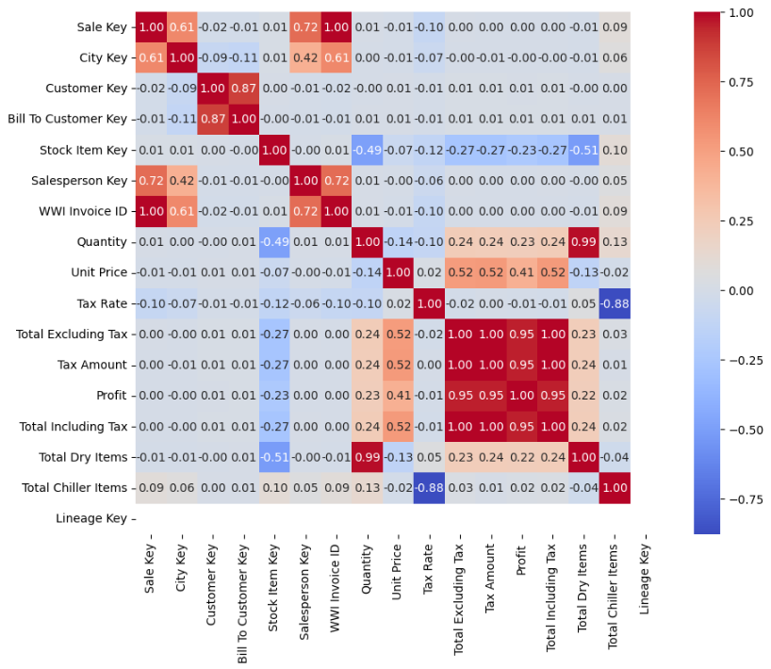
2- Data Set Manipulation With Python
In this stage we will see the correlation between
Columns in the fact sales :

Slide 9
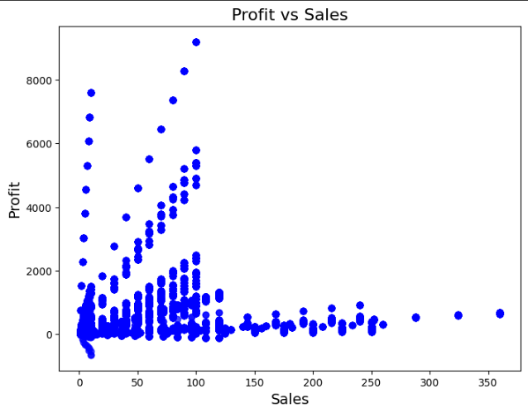
2- Data Set Manipulation With Python
In this stage we will see the distribution of the data :

Slide 10
3- Power BI Report
We Aim To Know:
What are the total sales?
What is the quantity of sales?
What is the total chiller item?
What are the total dry items?
Which group buying has the most quantity sales?
Which country has the most quantity sales?
What are the quantity sales of chiller and dry products over time?
What is the total profit?
What is the profitability?
Which country has the most profit?
What is the profit over time?

Slide 11
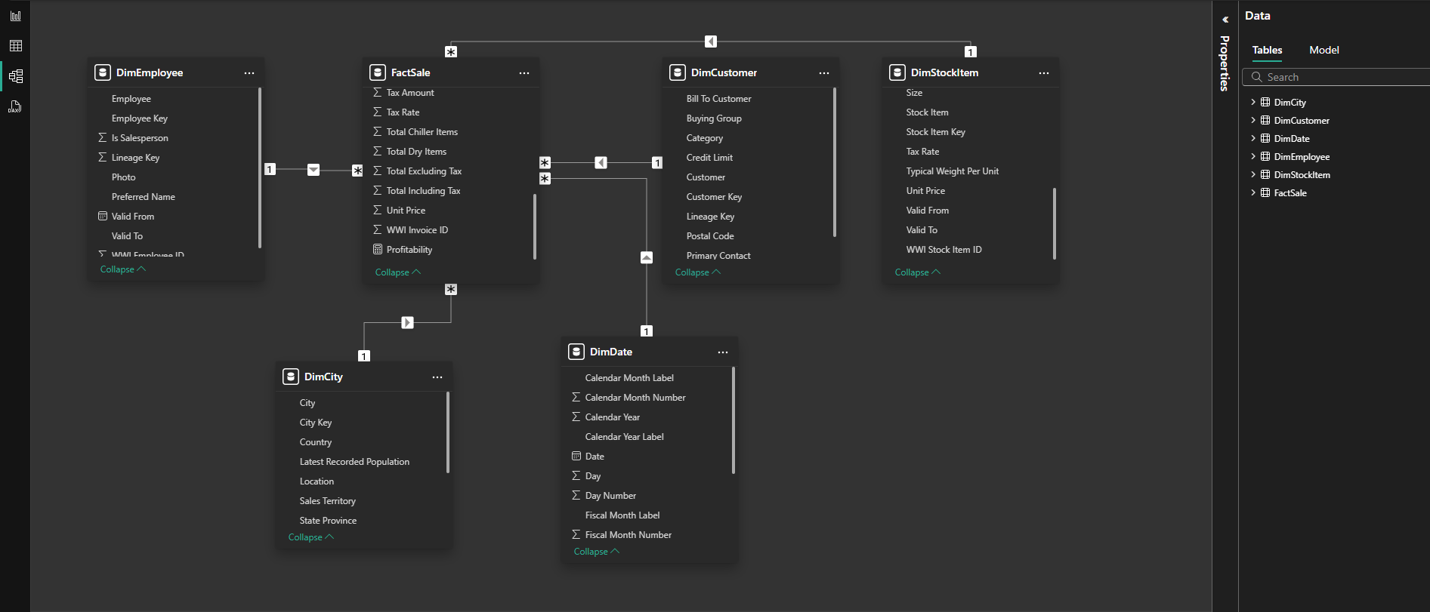
3- Power BI Report
Data Modeling :

Slide 12
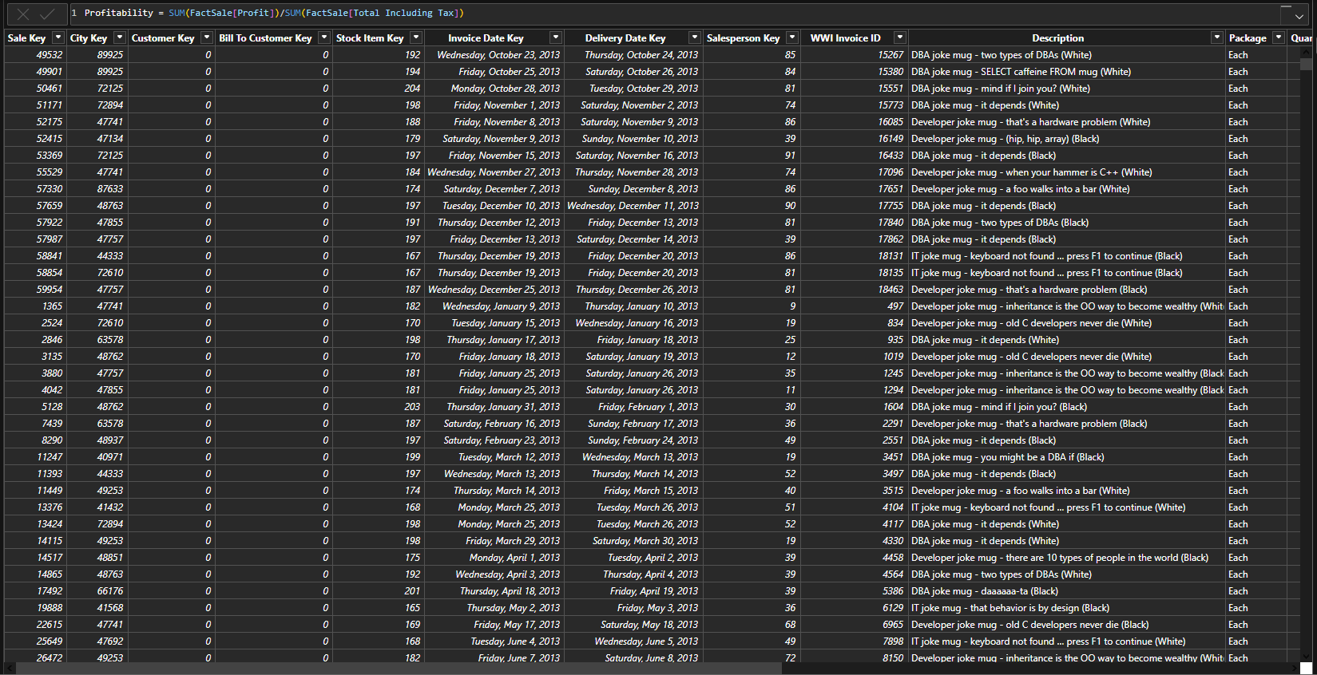
3- Power BI Report
Table View : we create a ( probability ) measure

Slide 13
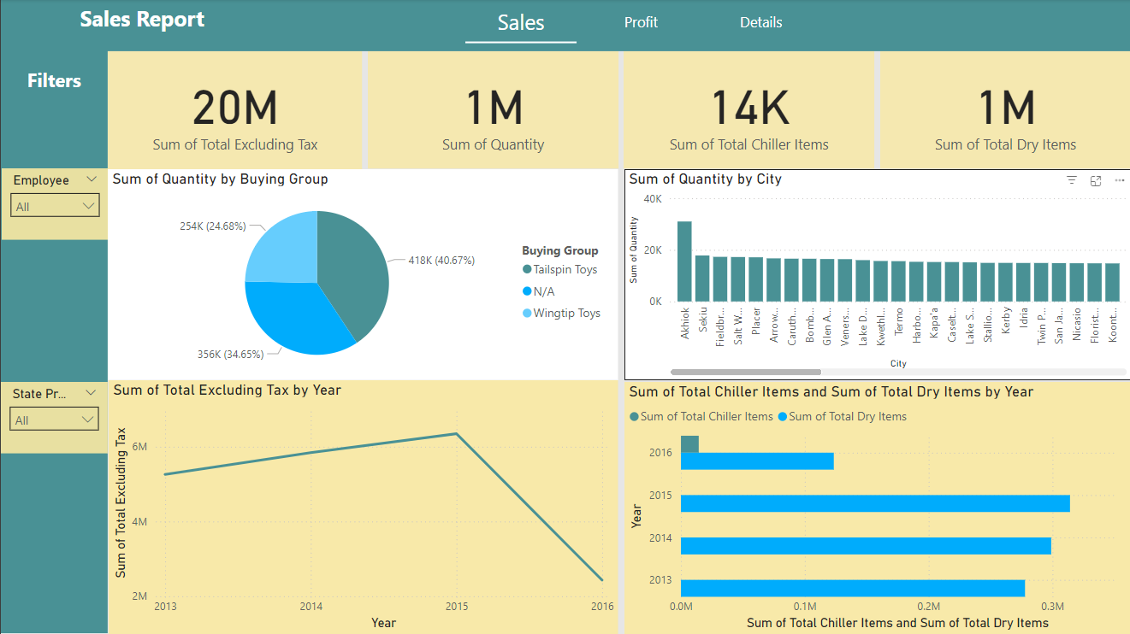
3- Power BI Report

Slide 14
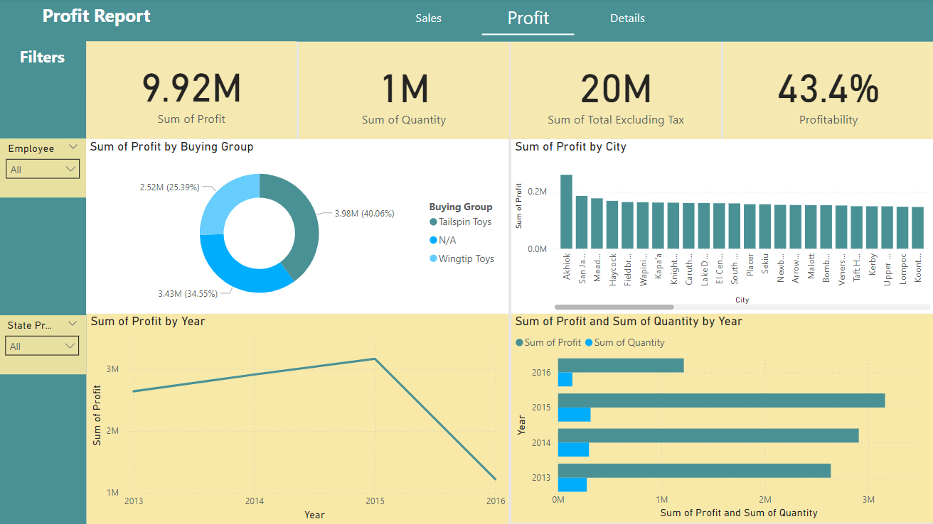
3- Power BI Report

Slide 15
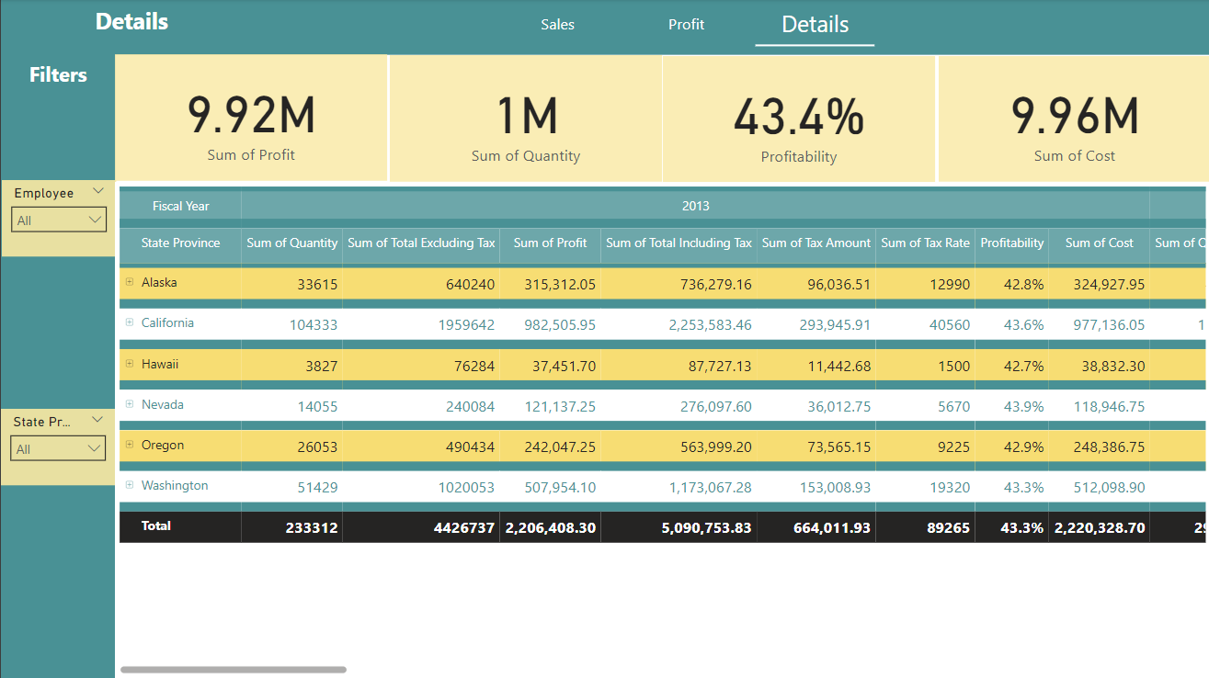
3- Power BI Report

Slide 16
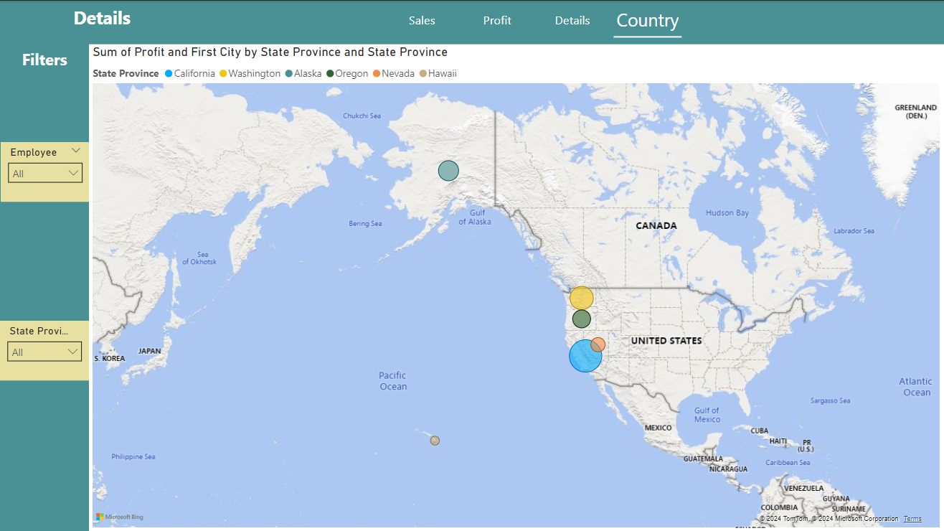
2- Power BI Report

Slide 17
4-conclusion
1- the total sales including tax is (20M)
2-the quantity of sold product is (1M)
3-the biggest buying group is (tailspin toys)
4- the best selling products is (dry items)
5-the biggest state for achieving profit is (California)

Slide 18
4-conclusion
6- the total profit is (9.92M)
7-the profitability of sold product is (43.4%)
8-the most profitable year is (2015)
9-the lowest profitable year is (2016)
10-the lowest state for achieving profit is (Hawaii)
11- the most sold item is (20 mm double sided bubble wrap 50m)

Slide 19

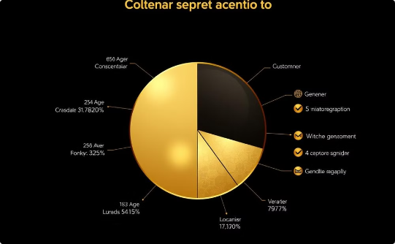
Thanks
By: Ahmed Mohammed Mohammed Said

